Slide 1
The Battle of the Neighborhoods
Applied Data Science Capstone by IBM/Coursera

Slide 2
Predicting the best place for opening an Italian restaurant in Paris
As we can all assume, Paris has a lot of restaurants. We are planning on opening an Italian restaurant, without any of them nearby.
We will try to find a place where there are fewer of them. Also, that location has to be popular for tourists, because we don't want it to be too far from the city.

Slide 3
Data acquision and data cleaning
We have collected our data from the Foursquare API mainly since it had information about latitude, longitude and addresses that we needed
We have also used https://france-geojson.gregoiredavid.fr/ in order to obtain information about districts in Paris and label them on our map
Since most of our data came in correct format, there wasn’t much of a cleaning job left to do

Slide 4
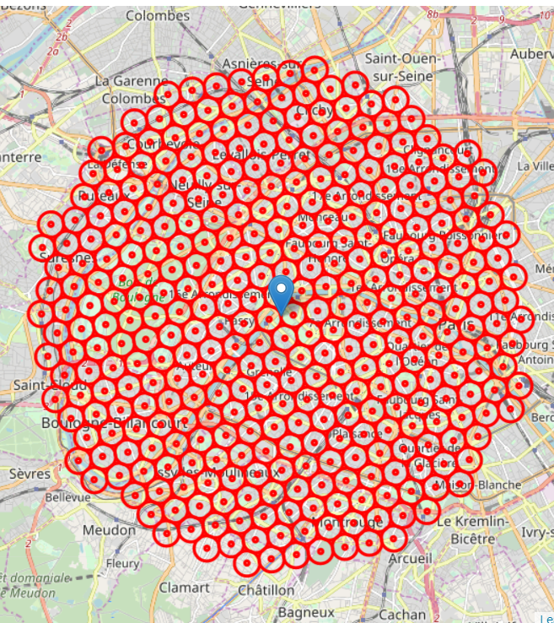
Slicing the Paris into little areas
We have sliced them so that they are equally spaced, centered around city center, and within ~6km from Eiffel Tower

Slide 5
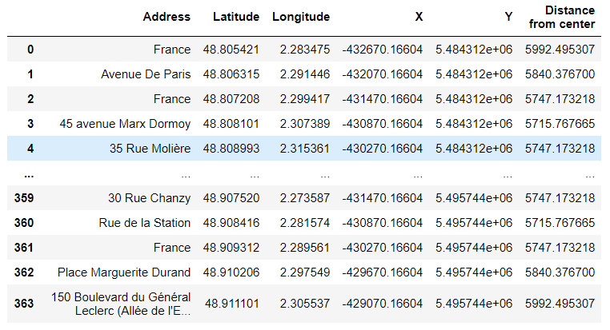
Locations inside our areas
We have gathered information about the locations inside our areas using the Foursquare API
The data is interpreted in the data frame format for easier manipulating and reading

Slide 6
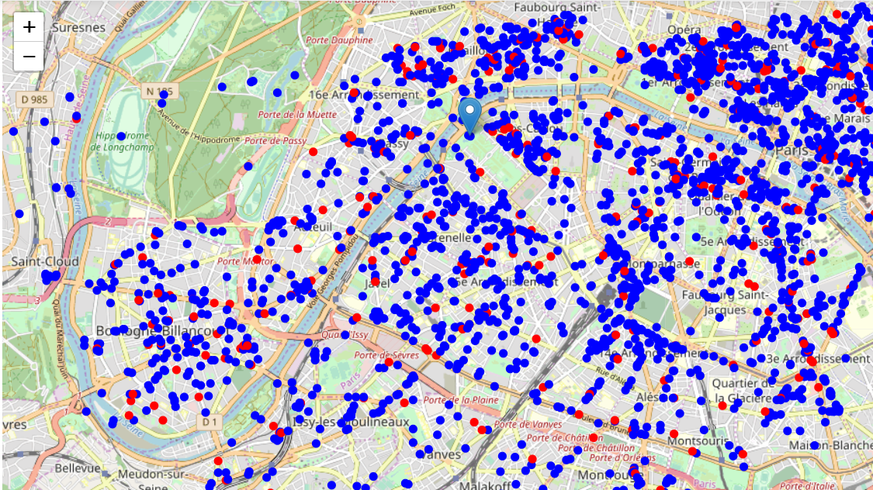
Restaurants in Paris
Blue dots are restaurants other than Italian
Red ones are Italian restaurants

Slide 7
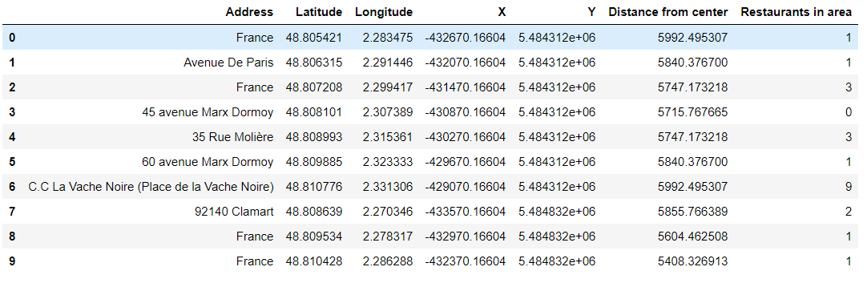
Restaurants nearby our locations

Slide 8
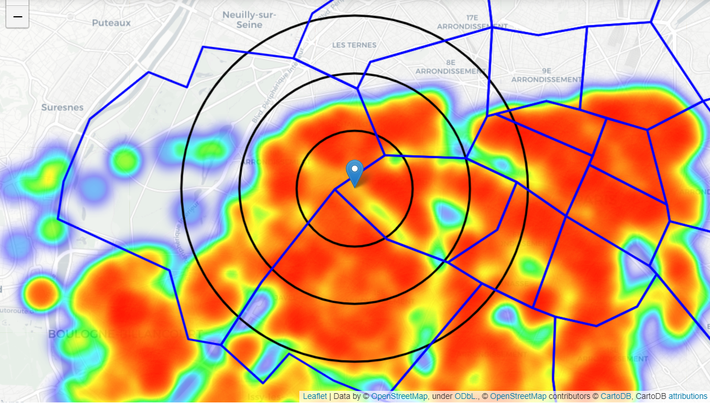
Heatmap including all restaurants (circles: 1km, 2km and 3km)

Slide 9
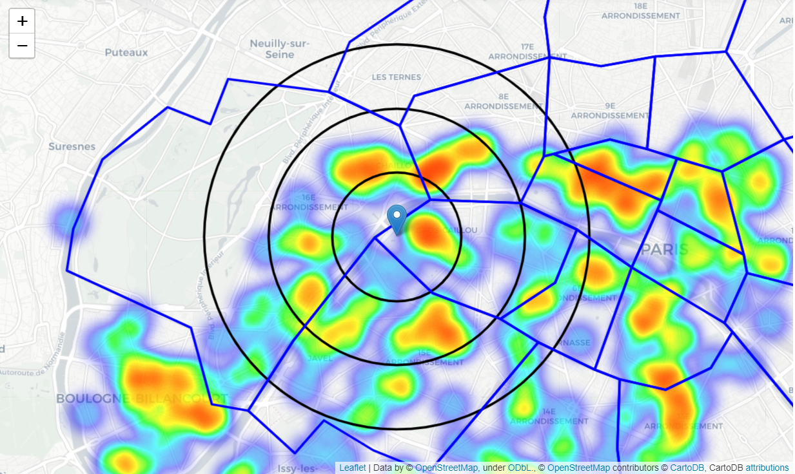
Heatmap displaying Italian restaurants circles(1km, 2km and 3km)

Slide 10
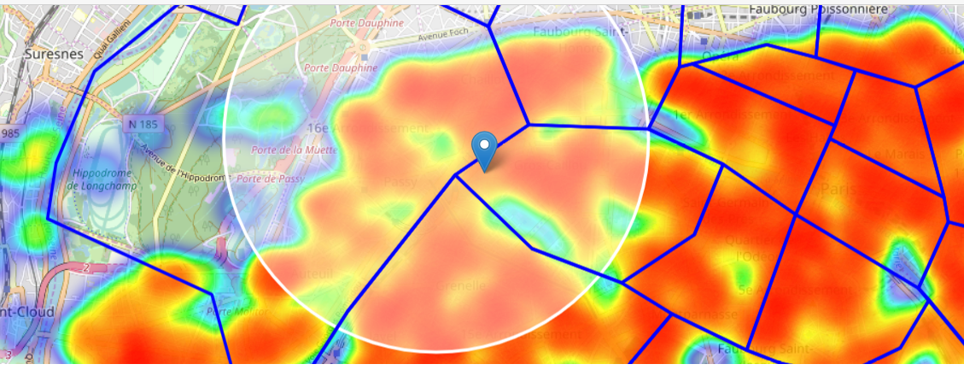
Selected area that we are interested in

Slide 11
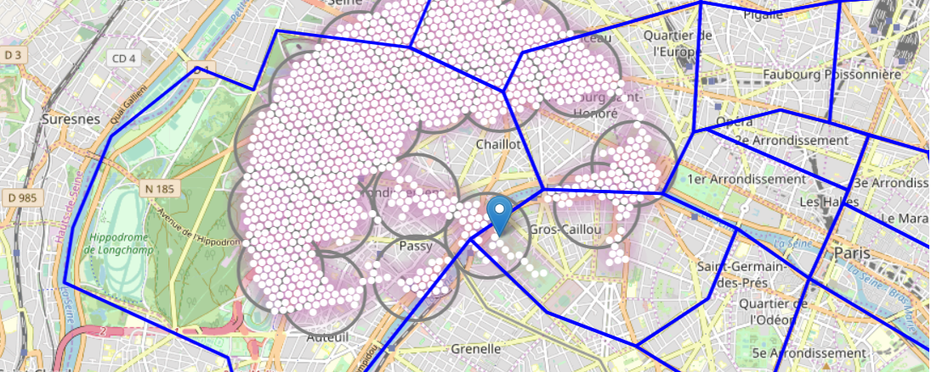
Clustering available locations

Slide 12
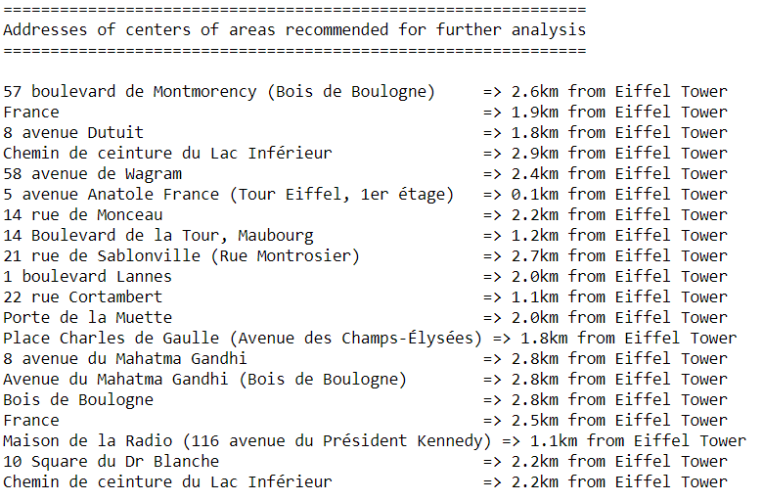
Distance from Eiffel Tower
Here we can see distance of available places that have fulfilled the criteria
Criteria:
1. No more than four restaurants in radius of 250 meters
2. No Italian restaurants in radius of 200 meters

Slide 13
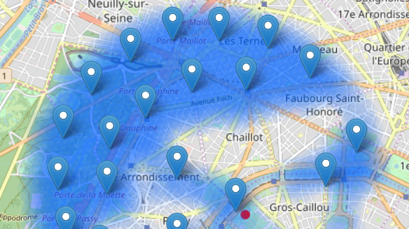
Best places to consider

Slide 14
Thank you!
Luka Sarić,
IT Consultant at Devoteam Serbia

